Slide 1
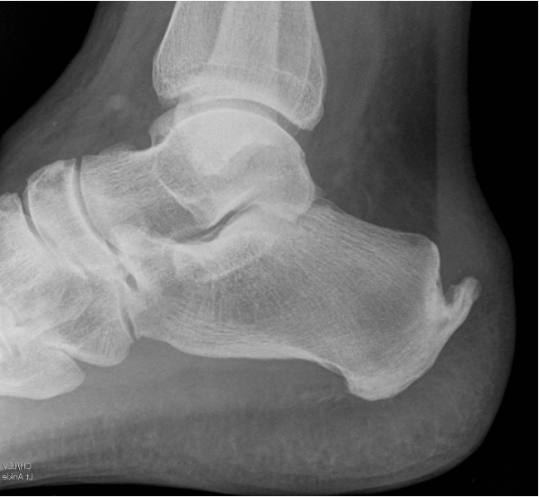
A
B
C
Figure 5 Simulated anterior shift of the apex of the Zadek Osteotomy. The weightbearing point is suggested to be used as the apex of the Zadek Osteotomy, by doing so the osteotomy will shorten the length of the calcaneus (the angle between the red lines represents PAIA, ie, the size of the Zadek osteotomy; the dashed light pink line and the solid pink line represent the calcaneal tuberosity before and after the osteotomy respectively; the yellow line and the green line represent the length of the calcaneus before and after the osteotomy), change the mechanical lever arm of the Achilles (the dashed blue lines and the solid blue lines represent the Achilles mechanical lever before and after the osteotomy respectively ) but won’t change the Calcaneal Pitch Angle (the angle between the two purple lines represents the Calcaneal Pitch angle before and after the osteotomy) (5A). If the apex of the osteotomy is placed anterior of the weightbearing point, then in addition to shortening the length of the calcaneus, and changing the mechanical lever arm of the Achilles, it will also reduce the Calcaneal Pitch angle (the angle between the two purple lines represents the Calcaneal Pitch angle before the osteotomy, and the ankle between the two orange lines represents the Calcaneal Pitch angle after the osteotomy ) (5 B)

